Slide 1
Instructional Technology Tools for Secondary Education
Web 2.0 Tools
Kiffany Cody

Slide 2

Engaged…or nah?

Slide 3
Why is it important for students to be active learners?
What does an active learner look like in your classroom? (Write 2-3 cues) 1 Minute
*Use sticky notes*

Slide 4
How can we use technology to engage our students?
E
N
G
A
G
E
With your tablemates, use this as an acronym to exemplify how to answer this question.
4 Minutes

Slide 5
Using Technology to Engage Our Students
Web 2.0 Tools
  A 2nd generation of the World Wide Web, focusing on collaboration and sharing info online (Webopedia, 2013).
Student Devices
  Laptops/Desktops
  iPads
  Tablets
  Mobile Phones
Internet accessibility

Slide 6
What Can You Do Today to Engage Our Students?
Begin using Web 2.0 Tools
Integrate technology into your current curriculum
Take-Away
  Use at least 2 Web 2.0 Tools in your classroom
  Resources for instructional media and technology

Slide 7
Remind 101
Web Address: https://www.remind.com/
Sign up for a free account
Create your class and roster
Set office hours and other settings

Slide 8
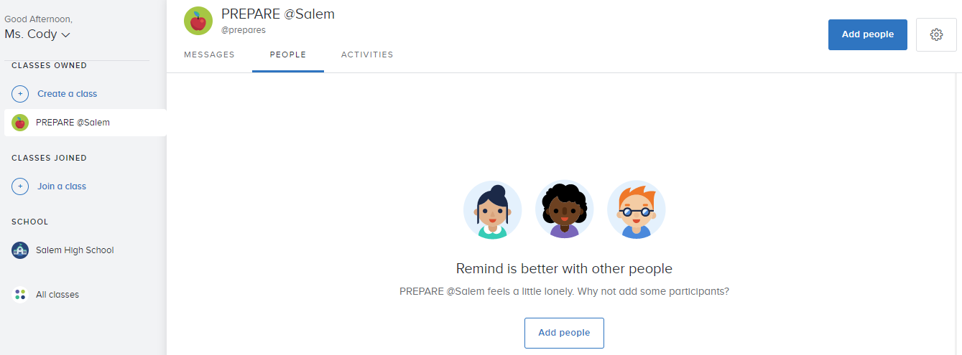
Remind101: (Step 1) Create a class

Slide 9
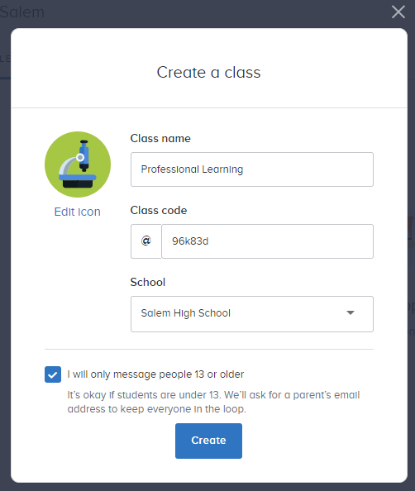
Remind101: (Step 2) Class name, code, & school

Slide 10
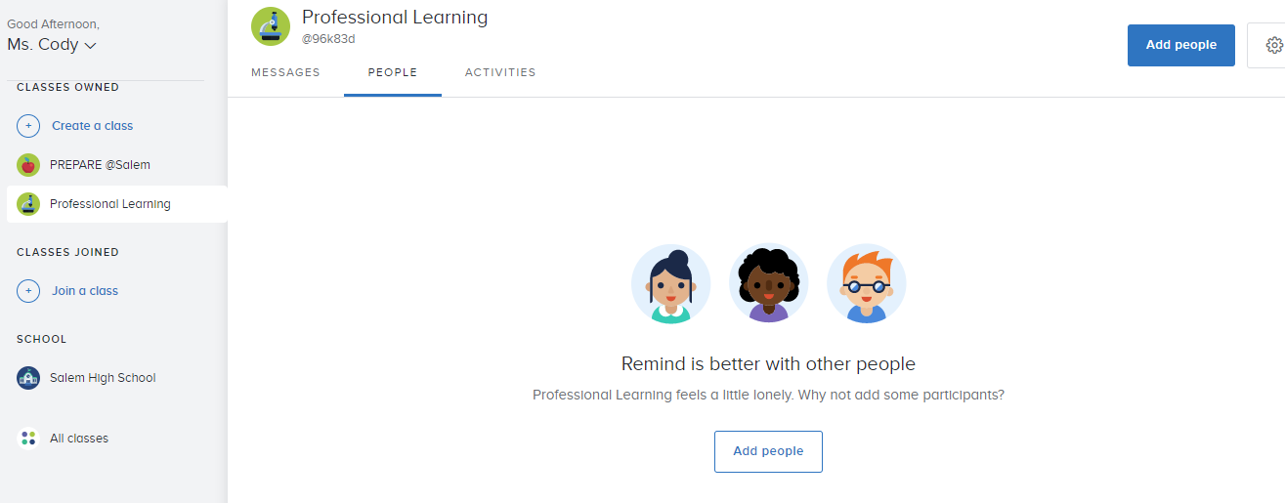
Remind101: (Step 3) Add People/Students

Slide 11
Remind101: What’s next?
Send a welcome message
Set your office hours (as needed)

Slide 12
What questions do you have?

Slide 13
Its Learning
Web Address: https://www.itslearning.com/welcome.aspx
Log in through your district site
View your courses
Upload class documents/files
Add links

Slide 14
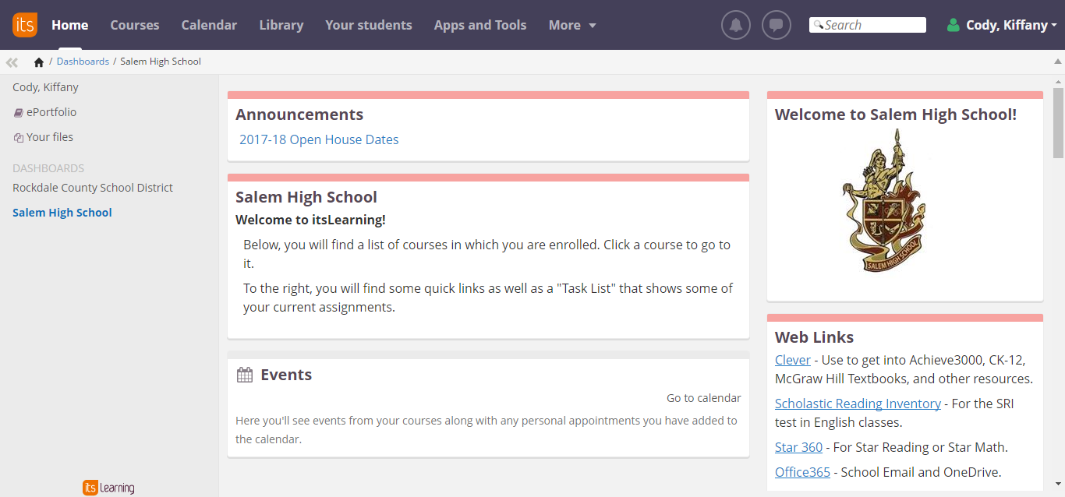
Its Learning
Click on Courses
Select Your Course

Slide 15
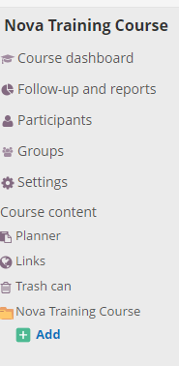
Its Learning
Click on “add”
Start adding to your course
  Syllabus
  Assignment
  Assessment

Slide 16
Helpful Videos
Adding a course in Its Learning: https://youtu.be/lLVFpBgTAJA
Its Learning Messaging: https://youtu.be/uJAJgv3i2GA
Remind 101 Activities Walkthrough: https://youtu.be/nT4gseF4r4k
Remind 101: How to Create a Class https://youtu.be/HiHH1p9XLXM

Slide 17
Other Web 2.0 Tools
IXL: www.ixl.com
TenMarks: www.tenmarks.com
Del.ico.us: https://del.icio.us/
Pinterest: www.pinterest.com
Edmodo: www.Edmodo.com
Schoology: www.schoology.com
Socratic: https://socratic.org/
Prezi: www.prezi.com
Kahoot: www.kahoot.com
Edublog: https://edublogs.org/
Quizizz: www.quizizz.com
Quizlet: www.quizlet.com
Geogebra: https://www.geogebra.org/
Poll Everywhere: https://socratic.org/

Slide 18

Resources
Web 2.0: How-To For Educators, 2nd Edition by Gwen Solomon & Lynne Schrum
https://www.remind.com/
https://www.itslearning.com/welcome.aspx

Slide 19
What questions do you have for me?
My email address: kncody21@gmail.com

Slide 20
References
Schrum, L., & Solomon, G. (2014). Web 2.0: How-To For Educators
  (2nd Ed.). Washington, DC: International Society for Technology in Education.

